Slide 1
Concurrent and Parallel Systems Thread prioritization – R/W lock
Dr Sergio Davies <sergio.davies@shu.ac.uk>
Department of computing
Sheffield Hallam University
28 October 2022

Slide 2
Topics
Last week: Thread pooling pattern
Today:
Readers / Writer (R/W) lock – Shared mutex lock – Multiple readers single writer (MRSW) lock

Slide 3
Programming patterns
Reusable solution to a commonly occurring problem in software design in a given context;
Usually an abstract version that can be easily transformed in the required code;
Has already been studied and implemented, and reduces the possibility of design flaws or coding errors;

Slide 4
Mutex
Mutex:
Single exclusive ownership (either reader or writer)
Denotes a critical section, where only one thread can access at any time;

Slide 5
Mutex Vs Readers / Writer lock
Mutex:
Single exclusive ownership (either reader or writer)
Denotes a critical section, where only one thread can access at any time;
Readers / Writer Lock – Multiple readers, single writer (MRSW) lock
Either single writer or multiple readers ownership
Denotes either a reader section, which multiple reader threads can a access at the same time, or a writer section, which a single writer thread can access at any time;
Allows higher concurrency when reading
Read/write preference or no preference

Slide 6
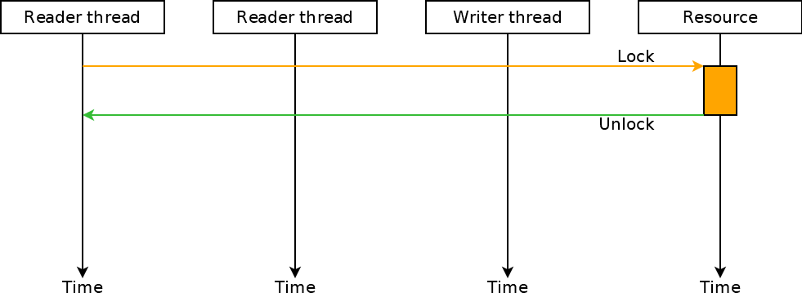
Mutex
Mutual exclusivity among threads

Slide 7
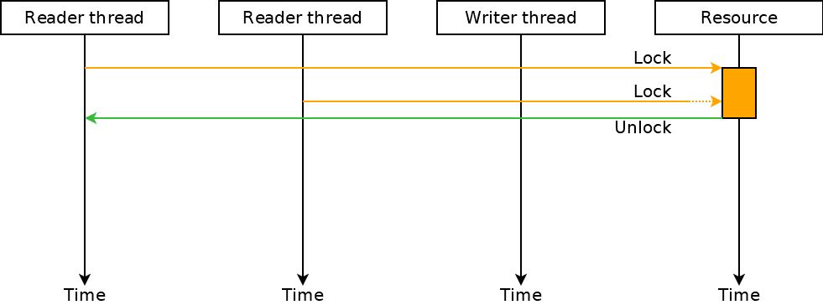
Mutex
Mutual exclusivity among threads

Slide 8
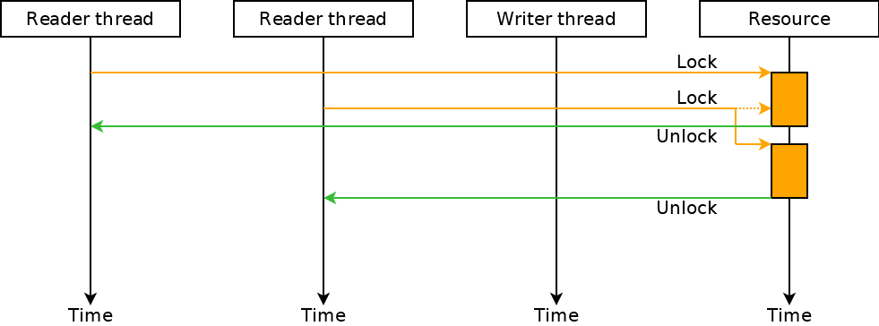
Mutex
Mutual exclusivity among threads

Slide 9
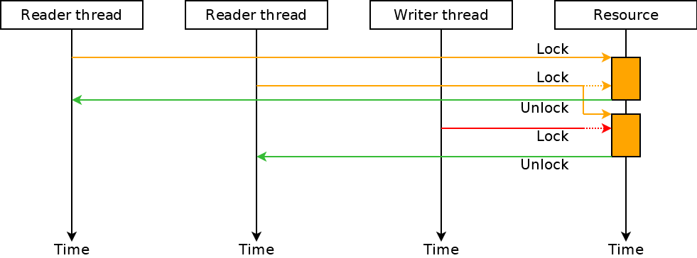
Mutex
Mutual exclusivity among threads

Slide 10
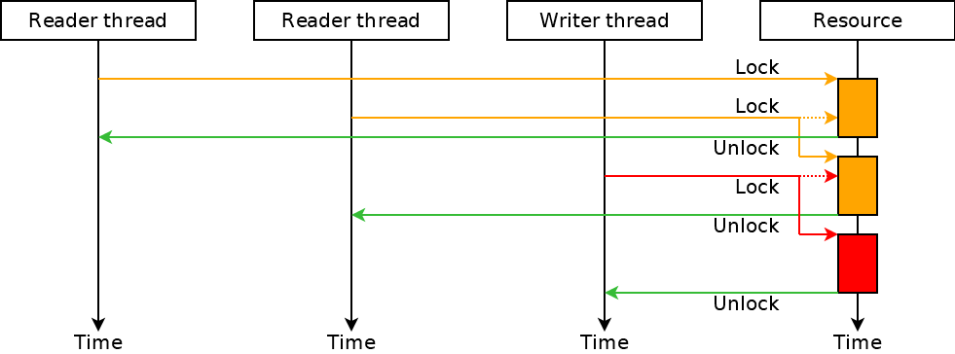
Mutex
Mutual exclusivity among threads

Slide 11
Mutex
Mutual exclusivity among threads
Is this exclusivity really required?

Slide 12
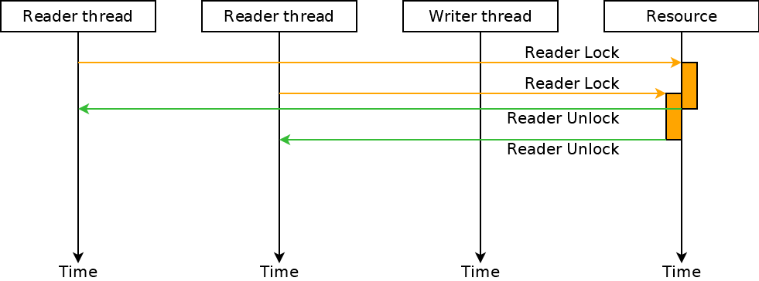
Readers / Writer lock
More concurrency in accessing the resource in reading

Slide 13
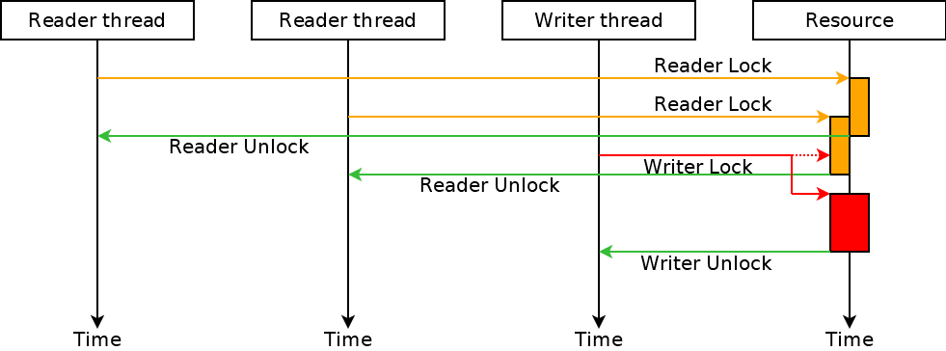
Readers / Writer lock
More concurrency in accessing the resource in reading
Exclusive access for writing

Slide 14
Mutex and lock in C++
Mutex (std::mutex) – Mutual exclusion object
std::mutex::lock() – lock the mutex – i.e. enter the critical section;
std::mutex::unlock() – unlock the mutex – i.e. exit the critical section;
Exclusive lock std::unique_lock<std::mutex> lock(mutex) An exclusive lock that uses a mutex to ensure a critical section of the code is accessed by one thread at a time;

Slide 15
Run example – ex13

Slide 16
Shared mutex in C++
std::shared_mutex – Mutual exclusion object with two levels of access:
Reader - several threads can share ownership of the same mutex.
std::shared_mutex::lock_shared() – Locks the mutex for shared ownership – i.e. starts a “Readers” critical section;
std::shared_mutex::unlock_shared() – Unlocks the shared ownership of the mutex – i.e. ends a “Readers” critical section;
Writer - only one thread can own the mutex.
std::shared_mutex::lock() – Locks the mutex for unique ownership – i.e. starts a “Writer” critical section;
std::shared_mutex::unlock() – Unlocks the unique ownership of the mutex – i.e. ends a “Writer” critical section;

Slide 17
Locks for shared mutexes in C++
Exclusive lock: std::unique_lock<std::shared_mutex> lock(shared_mutex) An exclusive lock that uses a mutex to ensure a critical section of the code is accessed by one thread at a time. It is used to access a critical section with a “writer” thread
Shared lock: std::shared_lock<std::shared_mutex> lock(shared_mutex) A lock that allows to share a mutex among multiple “reader” threads to ensure a critical section cannot be accessed by “writer” threads while “reader” threads are still in the critical section;

Slide 18
Shared lock - MRSW
Pros of a shared lock (R/W lock):
Allows higher concurrency when reading;
Cons of a shared lock (R/W lock or shared lock):
Overhead in complexity;
Specific APIs for reader and writer (increased coding complexity);
Switching between reader and writer mode may require releasing and reacquiring the lock;
Changing access “level” without unlocking may generate deadlock” (e.g. two threads both trying to switch from reader to writer);

Slide 19
Shared lock - MRSW
If reading a resource happens more often than writing the same resource (usual conditions), then increase in speedup!
In some conditions, the overhead of the shared lock may outweigh the benefits of the increased concurrency (especially if there is no gain in concurrency between multiple reader threads or readers take a long time to complete)
This is debated in the community and there is not a single preference: generally the improvements depend on the application, on the software and thread architecture, critical regions length, etc.

Slide 20
Reader / Writer priority
Three policies for thread priorities:
Reader priority: writers will not be able to acquire the lock as long as at least one reader holds it. Since multiple readers may hold the lock at once, this means that a writer may continue waiting for the lock while new readers are able to acquire the lock. This may lead to writer starvation, but maximises readers concurrency;
Writer priority: prevents any new reader from acquiring the lock if there is a writer queued and waiting for the lock. The writer will acquire the lock as soon as all readers which were already holding the lock have completed. This solves the writer starvation problem, but reduces readers concurrency;
Unspecified priority: does not provide any guarantees with regards reader vs. writer priority access. May allow more efficient implementation in some conditions;

Slide 21
Teaching schedule
LECTURES |  | LABS
Date | Topic | Date | Topic
30 Sep | Introduction to concurrency Introduction to threads in C++ Mutex variables | 27 Sep | Practical example of parallel computing Simple matrix multiplication
7 Oct | Time analysis in multithreaded software Return values from threads | 4 Oct | Multithreaded matrix multiplication – 2 approaches
14 Oct | Condition Variables Concurrency patterns Producer/consumer | 11 Oct | Evaluation of multi-threading speed-up
21 Oct | Thread pooling | 18 Oct | std::async / std::future / std::promise experiments Dining philosophers problem
28 Oct | Thread prioritisation – R/W Locks Coursework support | 25 Oct | NO SESSIONS
4 Nov | Coursework support | 1 Nov | Thread Pooling experiments R/W Locks
11 Nov | Coursework support | 8 Nov | Coursework support

